Slide 1
Household Consumption Expenditure
Buyung Airlangga

Slide 2
Introduction (1)
Household as consumer
Household as producer
Household Unincorporated Enterprises (HUE)
Owner of dwelling
Household expenditures on goods & services as consumer – final consumption expenditures
Household expenditures on goods & services as producer – intermediate consumption or capital formation

Slide 3
Intro … (2)
Concept of National
Including household expenditure aboad
Excluding non-resident household expenditure in domestic geography

Slide 4
Household final consumption expenditures
Domestic household consumption expenditures
Originated from domestic production
Originated from imports of goods & services
Household consumption expenditures abroad
Imports of goods and services

Slide 5
Expenditures … (2)
Goods & services which owned/used/ consumed by member of household
Expenditures on foods, clothes, housing, transportation, education, health, personal goods, durable goods, etc.
Including owned production, barter, transfer from other persons/institutions

Slide 6
Expenditures … (3)
Including:
Purchase of goods and services
Own used from own production
Imputed rent of own dwelling
Gifts/charities received
Cost of financial services directly charge to consumers
Insurance services, pension funds services
Household expenditures on permits, licences, etc. (as purchase of services)
Museum entry tickets, amusement arena, etc.

Slide 7
Expenditures … (4)
Excluded:
Transfer of goods
Goods and services as intermediate consumption or capital formation:
Household expenditures on productive activities (unincorporated enterprises)
Expenditures on housing repair & maintenance
Purchase of dwelling (as gross fixed capital formation)
Expenditure/purchase on valuable goods (as gross capital formation/valuables)
Purchase of land
Expenditure on taxes, such as driver license, automotive tax, hunting & fishing license, etc.
Current transfer (donation of money or in kinds to NPISH or other household)

Slide 8
Expenditures … (5)
Special treatments
Leasing – recorded as household purchase in cash
Lottery – recorded as net of gains (winning)
Imports of second-hand goods
Treated the same as buying new stuff
Transaction between households are not recorded
Fee and contribution to NPISH, labor union, professional affiliation organization – treated as current transfers

Slide 9
Classification (COICOP = Clasification of Individual Consumption by Purpose )
Foods and non-alcoholic beverages
Liquor, tobbaco and narcotic
Clothes and foot wear
Housing, water supply, electricity, gas and other fuels
Furniture, household appliance and other household minor repairs

Slide 10
Classification … (2)
Health
Transportation
Communication
Recreation and culture
Education
Restaurant and hotel
Other goods and services

Slide 11
Compilation method of household final consumption expenditure
Direct method
Household income & expenditure survey (Susenas/SBH)
Food balances (NBM)
International trade statistic (exports, imports)
Retail trade statistic
Commodity Flow Approach
supply of goods & services – IC – GC –GFCF – Exports = 0

Slide 12
Household Actual Final Consumption
Value of goods and services consumed and used by households
Including :
Household expenditures on consumption
Social Transfers received from government or NPISH

Slide 13
Social transfer in kinds
Government and NPISH final consumption expenditures as current transfer in kinds given to individuals or households
Expenditure of NPISH final consumption in the form of services to individuals/households (current transfer)
Expenditure of Government final consumption in the form of services to individuals/ households (current transfer)

Slide 14
Transfer in kinds … (2)
Amounts of transfer in kinds is recorded as income under Resources side of Redistribution of Income Account of household
and as uses in Adjusted Disposable Income of household

Slide 15
Transfer in kinds … (3)
Transfer in kinds is recorded under Uses side in Redistribution of income account
and it is subtracted from consumption expenditure under Uses side in Adjusted disposable income of general government and NPISH

Slide 16
Transfer in kinds … (4)
Government and NPISH expenditures which classified as transfer in kinds :
Health
Education
Culture, religion, other community services
Housing and re-use collection
Including purchase of goods and services made by government destined to be given to households, which is not part of government production activity

Slide 17
Transfer in kinds … (5)
Example : Government is allocated $50 mil. into education. Education institutions owned by government are received $12 mil. from tuition fee, books sales and other educational services.
Household consumption expenditure= $12 million
Hovernment consumption expenditure
= 50 – 12 = $38 million

Slide 18
Transfer in kinds … (6)
Government consumption expenditure on education is transfer in kinds
Transfer in kinds = $38 million
Household received (adjusted disposable income)
= household income + $38 mil. and
Household actual final consumption
= 12 + 38 = $50 million

Slide 19
Household final consumption expenditure account
Uses
Household consumption expenditure
Household saving
Resources
Disposable income
Compensation
Property income
Current Transfer

Slide 20
Household actual final consumption expenditure account
Uses
Household actual consumption
Household consumption expenditure
Individual consumption expenditure from government and NPISH
(transfer in kinds)
Household saving
Resources
Disposable income (adjusted)
Household disposable income
Transfer in kinds from government and NPISH

Slide 21
Data sources
Household consumption data from Household Income and Expenditure Survey (Susenas) and Household Budget Survey (SBH) as benchmark data;
Consumer Price Index (CPI) as deflator

Slide 22
Estimation method
Special study revealed that Susenas data on urban household consumption is under estimate, while rural household consumption is representative.
Adjustment being made to correct urban household consumption using ratios of consumption value based on SBH and urban household consumption based on Susenas.

Slide 23
Flowchart of household final consumption at current price
Urban
Correction factors
Adjusted urban household consumption
Household consumption (Susenas)
Household final consumption at current price
Rural

Slide 24
Flowchart of household final consumption at constant price
Adjusted urban household consumption
CPI
Adj. urban household consumption constant price)
Rural household consumption
Farmer’s term of trade index
Household final consumption at constant price

Slide 25
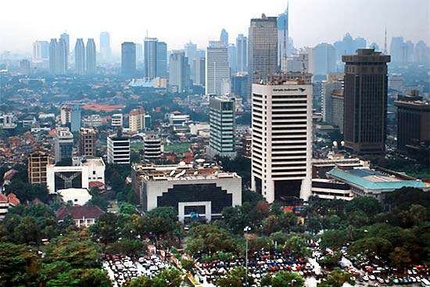
Thank you

